Slide 1


Slide 2


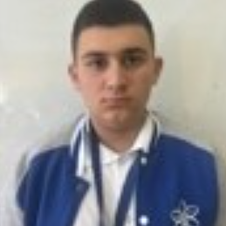

Team
Тодор Нешев: Scrum Trainer
Филип Филипов: Back-End Developer
Янко Янев: Designer
Николай Иванов: Front-End Developer

Slide 3
Our idea
Our idea is to create four simple word and math games using the C++ programming language, aiming to develop something fun and engaging that also offers an opportunity to learn.

Slide 4






Technologies

Slide 5
Now let’s check out
the project

